Slide 1
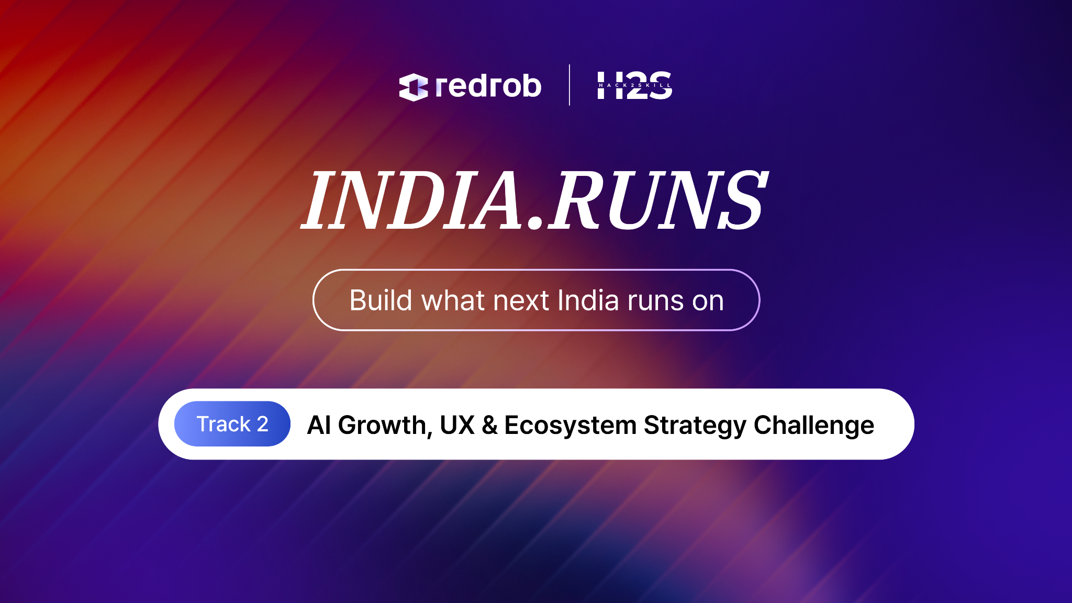

Slide 2

Redrob Context & Ideathon Scope
Redrob AI is building an AI-native ecosystem spanning hiring, productivity, communication, discovery, workflows, recommendations, automation, and intelligent user experiences.
Participants are encouraged to think beyond standalone applications and explore how their ideas can:
Extend existing Redrob capabilities
Improve experiences for Redrob users
Introduce new AI-native workflows
Strengthen ecosystem engagement and network effects

Slide 3

Important
Participants are not expected to build a completely new platform from scratch.
Strong submissions will demonstrate:
How the idea leverages existing Redrob capabilities
What new capability, workflow, or value layer is introduced
How the idea strengthens the overall Redrob ecosystem
Why Redrob is uniquely positioned to enable this experience

Slide 4
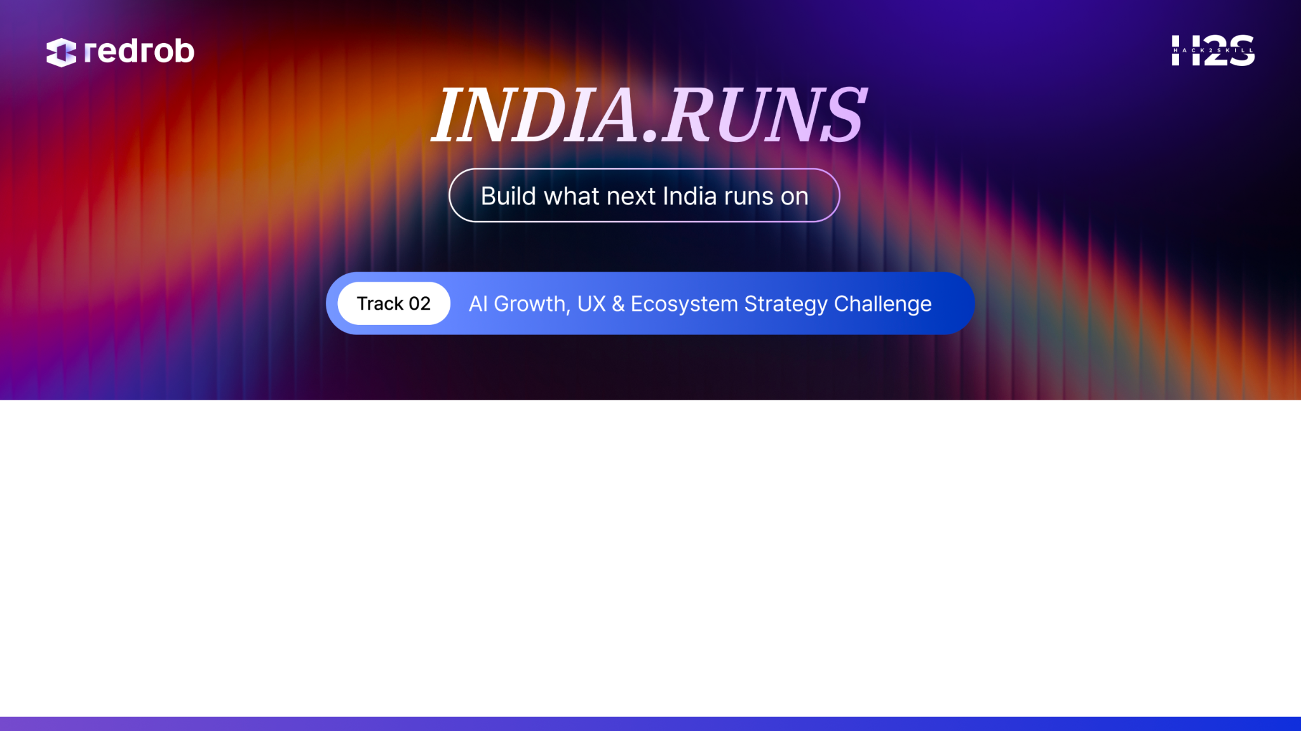
Team Name : Cyber Crusaders
Problem Statement : The traditional hiring process is slow and repetitive, causing recruiter fatigue and candidate drop-off. We are building 'Parallel Mind'—an AI digital twin for candidates that can autonomously conduct initial screening interviews 24/7 on the Redrob platform.
Team Members : Alan John , Sudipta Sanki

Slide 5
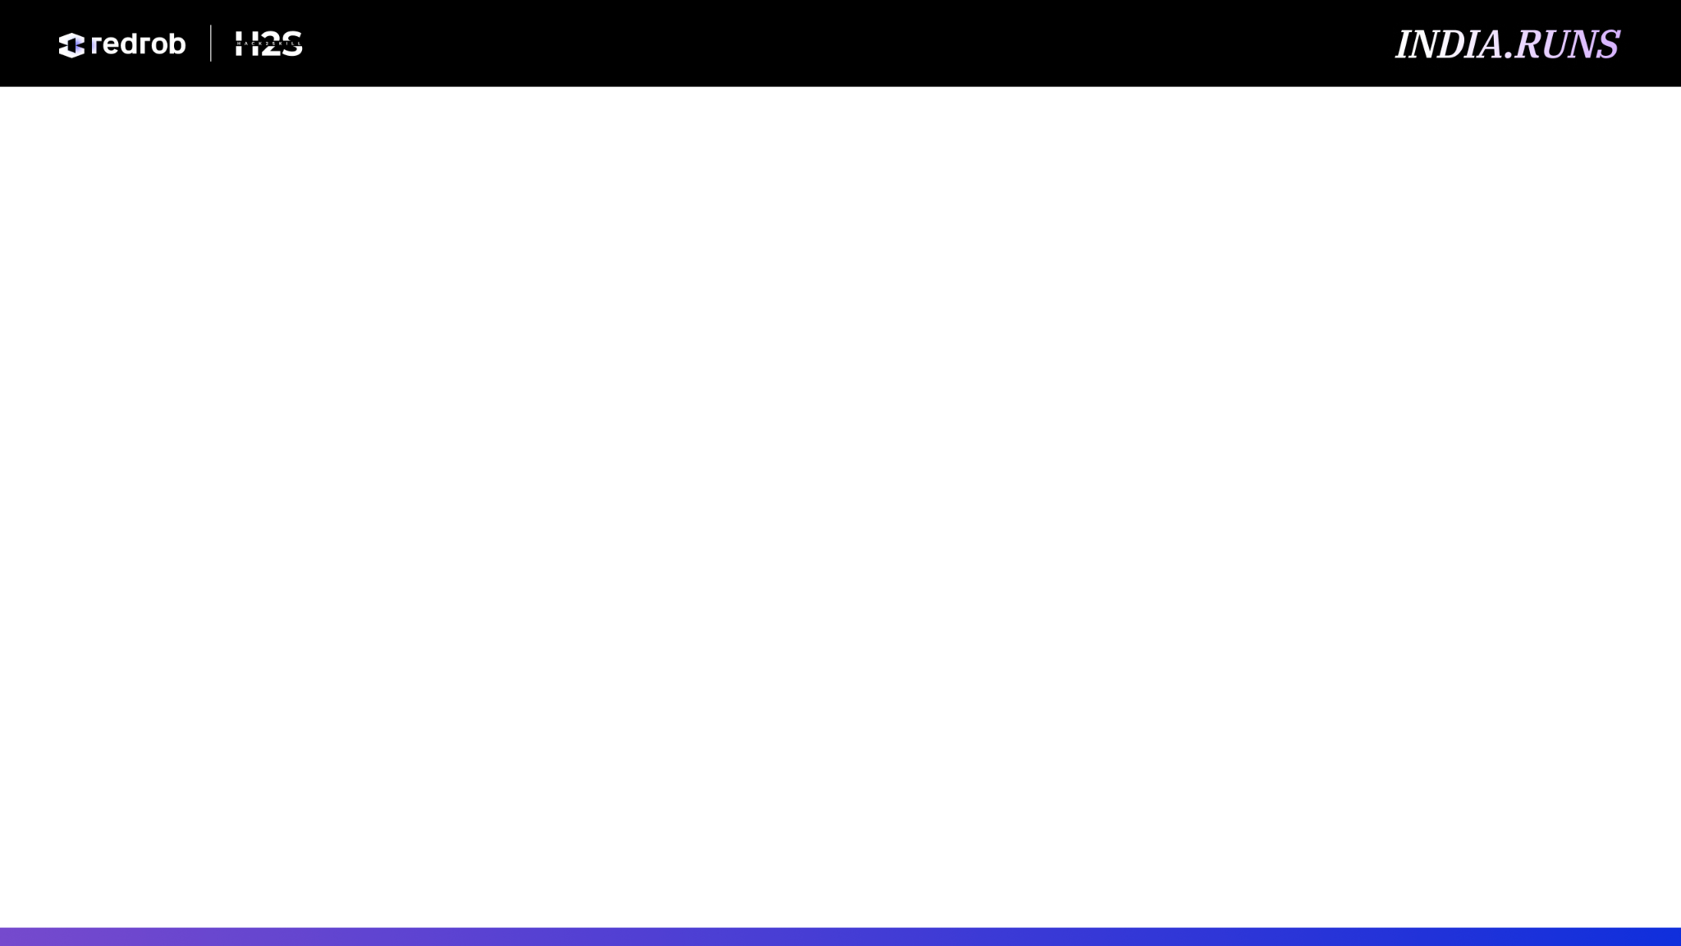
Problem & User Insight
Questions
Challenge: Low conversion rates in the top-of-funnel hiring process due to scheduling friction and repetitive screening. Recruiters spend 40% of their time on initial calls. Evidence: Industry data shows a 60% candidate drop-off when scheduling takes more than 3 days. Opportunity for Redrob: By introducing 'Parallel Mind' AI Twins, Redrob becomes a highly sticky platform where candidates train their twins once, and recruiters get instant, asynchronous screening capabilities. This drives massive engagement and trust.

Slide 6
Audience & Persona Analysis
Questions
Target Audience: Tech recruiters and passive job seekers. Motivations: Recruiters want fast, high-signal screening. Candidates want to apply to multiple jobs without repeating the same introductory interview. Barriers: Synchronous scheduling, time zones, and interview fatigue.
Mandatory Visual
Persona Framework

Slide 7
Proposed Solution / Strategy
Questions
Proposed Feature: 'Parallel Mind' - Candidates connect their GitHub, resume, and take a 10-min calibration interview to generate their AI Twin. The Twin sits on their Redrob profile. Differentiator: It's a 2-way interactive agent, not just a static profile. Recruiters can 'talk' to the candidate's twin anytime. Improvement: Radically compresses the discovery and initial screening journey on Redrob.

Slide 8
User Journey & Experience Design
Questions
Discovery & Onboarding: Candidates are prompted to 'Clone Yourself' upon Redrob signup. They upload docs and do a short voice interview. Engagement: Recruiters see a 'Chat with AI Twin' button on profiles. They ask custom screening questions. Value: Candidates get more interviews passively. Recruiters screen 10x faster.
Mandatory Visual
User Journey Map

Slide 9
Experience Mockups / Wireframes
Questions
Experience: A sleek chat interface on the candidate's Redrob profile. The recruiter types or speaks questions, and the AI Twin responds in the candidate's persona, citing their actual experience. Fit: Integrates seamlessly into the existing Redrob Candidate Profile view as a new interactive tab.
Mandatory Visual
Mockups / Wireframes

Slide 10
Growth & Engagement Model
Questions
Acquisition: Candidates invite peers to 'test their AI twin'. Activation: The 'aha' moment when a candidate gets a fast-tracked offer because their Twin aced the initial screen. Retention: Candidates keep their Twin updated as their skills grow, creating a lifelong connection to Redrob.
Mandatory Visual
Growth Funnel / Growth Loop Diagram

Slide 11
Redrob Ecosystem & Platform Impact
Questions
Stakeholders: Candidates (save time, get more offers), Recruiters (screen instantly at scale), Redrob (becomes the ultimate data-rich talent marketplace). Ecosystem Effects: The more candidates train their twins, the more valuable Redrob becomes to employers, creating a strong data network effect.
Mandatory Visual
Ecosystem Flywheel Diagram

Slide 12
Business Model & Monetization
Questions
Value: Redrob captures the entire top-of-funnel interview layer. Growth: Transforms Redrob from a sourcing platform to a full-stack automated hiring ecosystem. Monetization: Charge employers a premium subscription for unlimited AI Twin interactions, or a micro-transaction fee (NexusTokens) per AI interview.

Slide 13
Rollout & Adoption Strategy
Questions
Launch: Beta release to top 5% of candidates (ScoutRena elites) to build FOMO. Education: A short interactive video showing a Twin landing a job while the candidate sleeps. Validation: Track Recruiter CSAT and Candidate time-saved in the first 30 days.
Recommended Visual
Rollout Roadmap

Slide 14
Success Metrics
Questions
KPIs: 1. Number of AI Twin interactions per week. 2. Conversion rate from AI Screen to Final Human Interview. 3. Candidate time saved (hours). 4. Recruiter adoption rate of the 'Chat with Twin' feature.

Slide 15
Future Vision
Questions
In 3 years, the 'Parallel Mind' AI Twin is the industry standard. Resumes are obsolete. Redrob is the central hub where millions of AI Twins negotiate, interview, and match with opportunities autonomously 24/7.

Slide 16
